Slide 1
Diffusion Imitative Planning at Scale in Noisy Multi-Agent Traffic
Presenter: Luobin Wang
Intern Summer 2025
2nd Year PhD at UCSD
Manager: Pranav Desai
Mentor: Abhishek Peri
@qualcomm

Slide 2
Motivation: Why is Motion Planning Hard?
Diffusion Planner
Large-Scale Multi-Agent Traffic
Our Method
Results

Slide 3
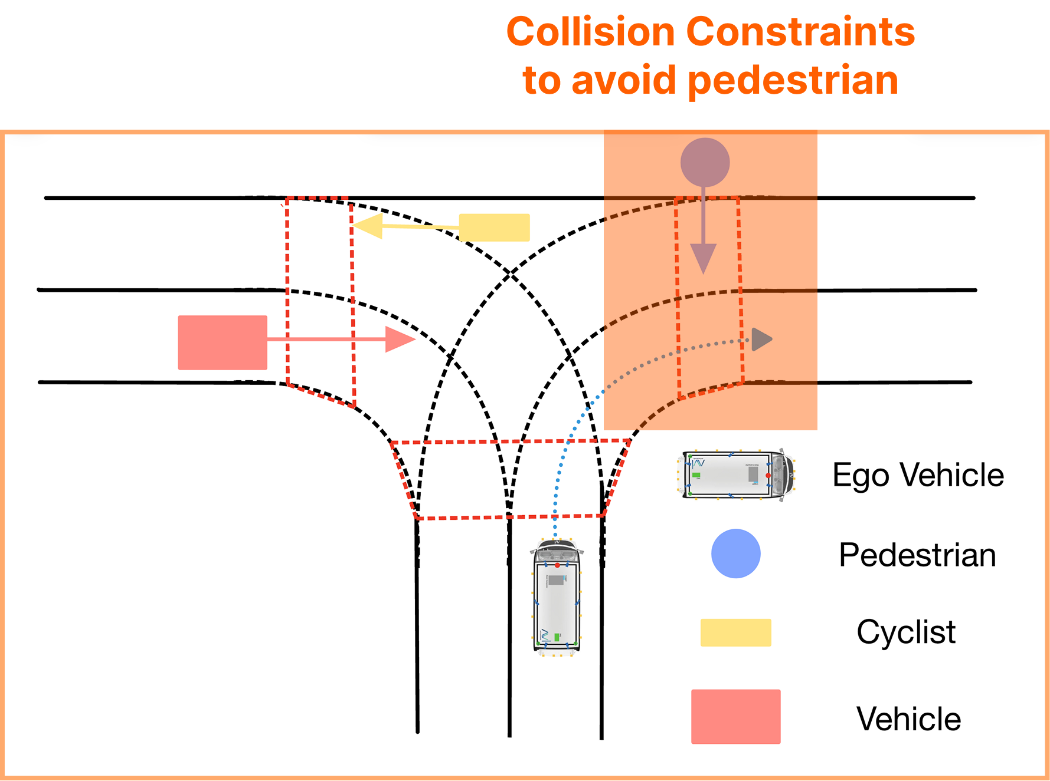
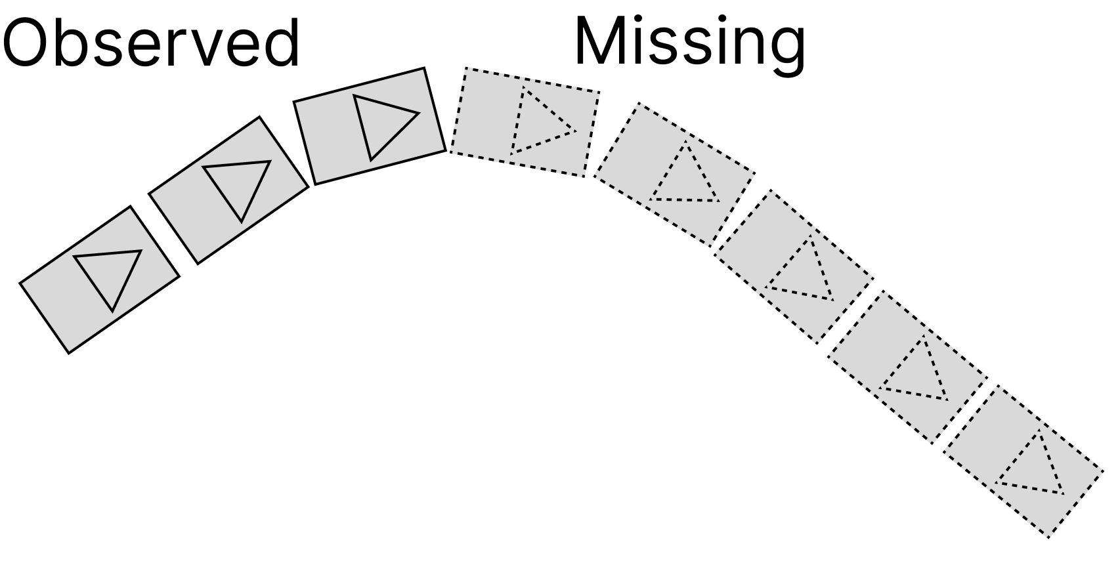
Why is Motion Planning Hard to Learn?
Rare efforts are spent in 2 & 3. This make learning-based models hard to be reliable.
1. Agent interactions grow exponentially complicated.
2. Dataset collected in real world is incomplete.
3. Planner executions under varying constraints during inference.
The planner must generalize across scenarios with varying numbers of traffic participants, from minimal interactions to heavy traffic.
Because of sensor noise and reachability constraints, it is impossible to capture complete trajectories of all traffic participants. As a result, some observations are missing or inaccurate.
Although a planner may achieve strong performance during training, it can fail at inference since safety and comfort constraints must be enforced at execution but are absent during training.
Detection boundary
Fig. 1: Planning Score of SOTA method w.r.t. Number of Agents
Fig. 2: Recorded trajectory of an observed agent has missing states
Fig. 3: Constraints have to be enforced during inference to ensure safety.
Notes:
There are two main approaches to learn a planner. One is that we need to construct a very good simulator that has minimal sim2real gap then we can adopt RL to learn a policy. In such simulator, we have full observability of all agent states. On the other hand, we can build fleets and collect dataset from the real-world. Then we apply imitation learning to imitate the expert policy from this dataset. In this work, we focus on learning from real-world dataset using diffusion-based planners. It turns out to be a pretty hard but promising direction. Let’s start. When human drives, we usually only focus on several agents that will affect our driving. We don’t exactly know how our brain selects whom to pay attention to, but whenever a critical agent appears, we can react efficiently. Such attention mechanism is built on top of the fact our eyes can observe them. Being able to include agents that can potentially interact with the ego agents is crucial for a planner. However, resent works found that when we include more agents in the future predictions, the planner performance tend to drop. There are two reasons here. One is the complexity of the agent interactions become exponentially complex when number of agents grow. This suggests us to have a larger model. The second reason is a root problem in real world collected dataset. Due to the sensor noise and the reachability limits, we do not have complete trajectories of other agents most of the time. If a car drives out of the detection boundary, we will lose its track. The rate of missing states is around 25 percent for the entire scenario and around 50 percent close to the end of a sequence of collected sample. Last but not least, when we execute driving policy, we often needs to specify some constraints such as collision avoidance or speed limits. These constraints are implicit in the dataset and it is hard to optimize the model for those constraints with imitation learning.

Slide 4
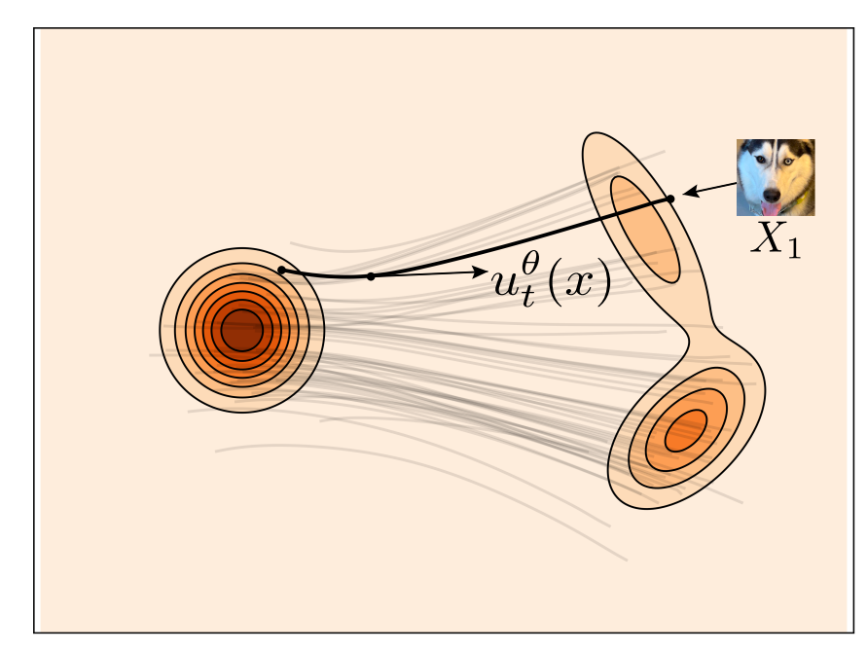
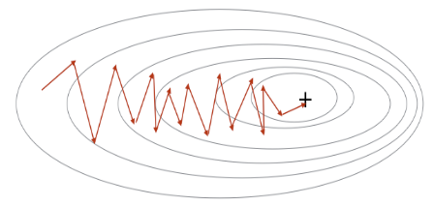
Diffusion Model Overview
Diffusion models is similar to gradient-based optimization
Diffusion predicts score $∇_{x}\log{P(X)}$. It is equivalent to gradient we compute is SGD, only in distribution space.
X*
X_0
X_0
Stochastic Gradient Descent
Diffusion models
Notes:
Let’s quickly go over the high-level ideas of diffusion model before we jump to using diffusion model as a planner. Diffusion model is very similar to gradient based optimization. In gradient based optimization, we start from a random sample and compute its gradient based on some local measurement (left figure). Diffusion model also does the same. It predicts the gradient that leads to the optimal configuration in the distribution space. (Figure)

Slide 5
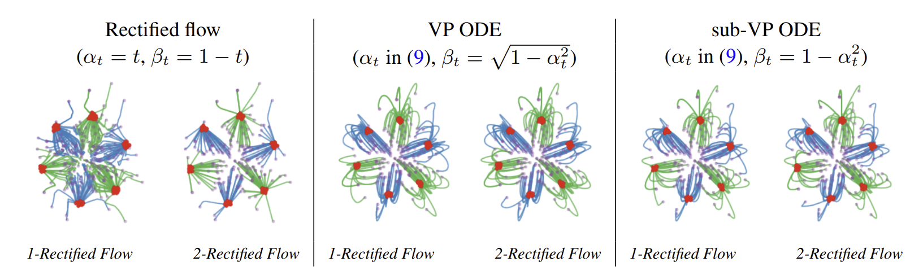
Diffusion Model Overview
Diffusion model learns strictly defined probability path
It is infeasible to fit all the gradients in the entire distribution space, so we design specific probability path that makes the learning easier.
Optimal Transport
Different probability path design

Slide 6
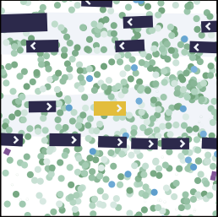
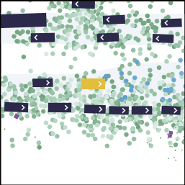
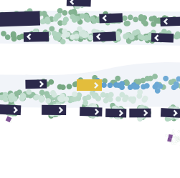
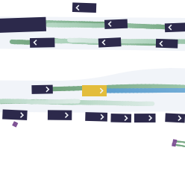
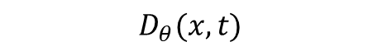
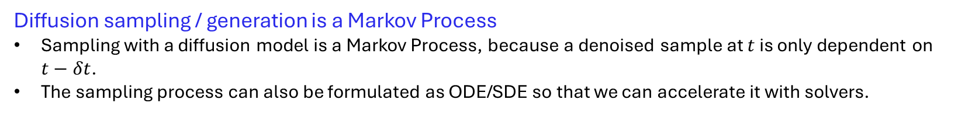
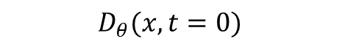
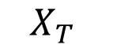
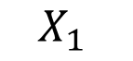
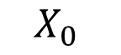
Diffusion Model Overview
Diffusion sampling / generation is a Markov Process
Sampling with a diffusion model is a Markov Process, because a denoised sample at $t$ is only dependent on $t−δt$.
The sampling process can also be formulated as ODE/SDE so that we can accelerate it with solvers.
$$D_{θ}(x, t=0)$$
$$D_{θ}(x, t)$$
$$X_{0}$$
$$X_{1}$$
…
$$X_{T}$$

Slide 7
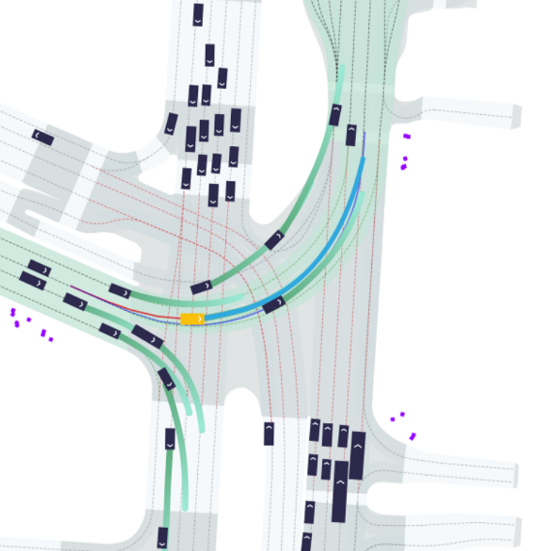
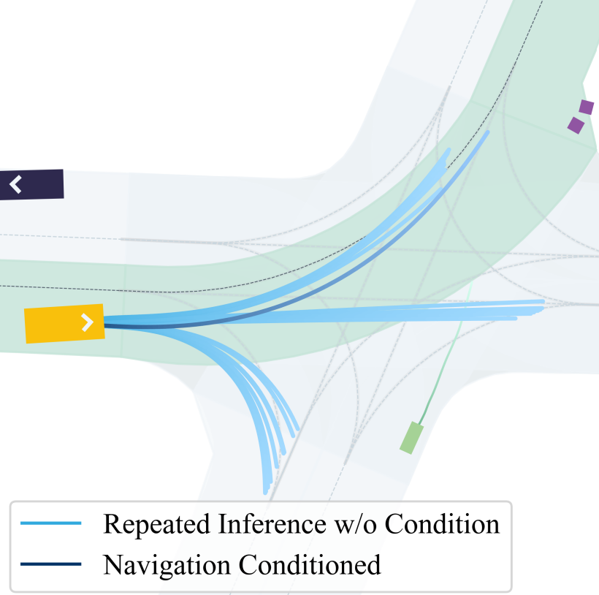
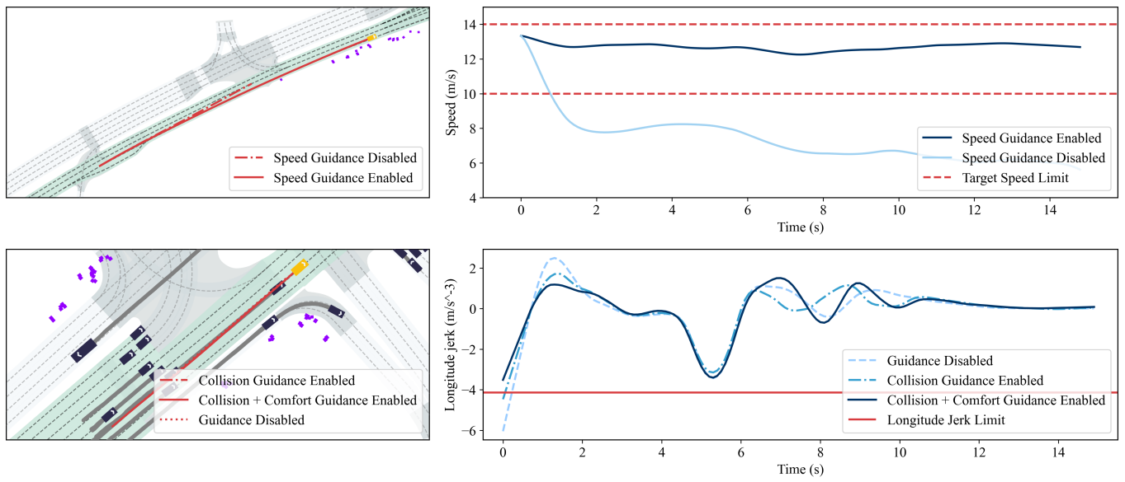
Diffusion Model as An Imitative Motion Planner
Benefits of Diffusion Models
Capture multi-modal agent interactions at a high fidelity.
Jointly generate ego plan and other agents’ future predictions.
Flexibility to apply inference-time constraints (e.g. collision, speed limit).

Slide 8
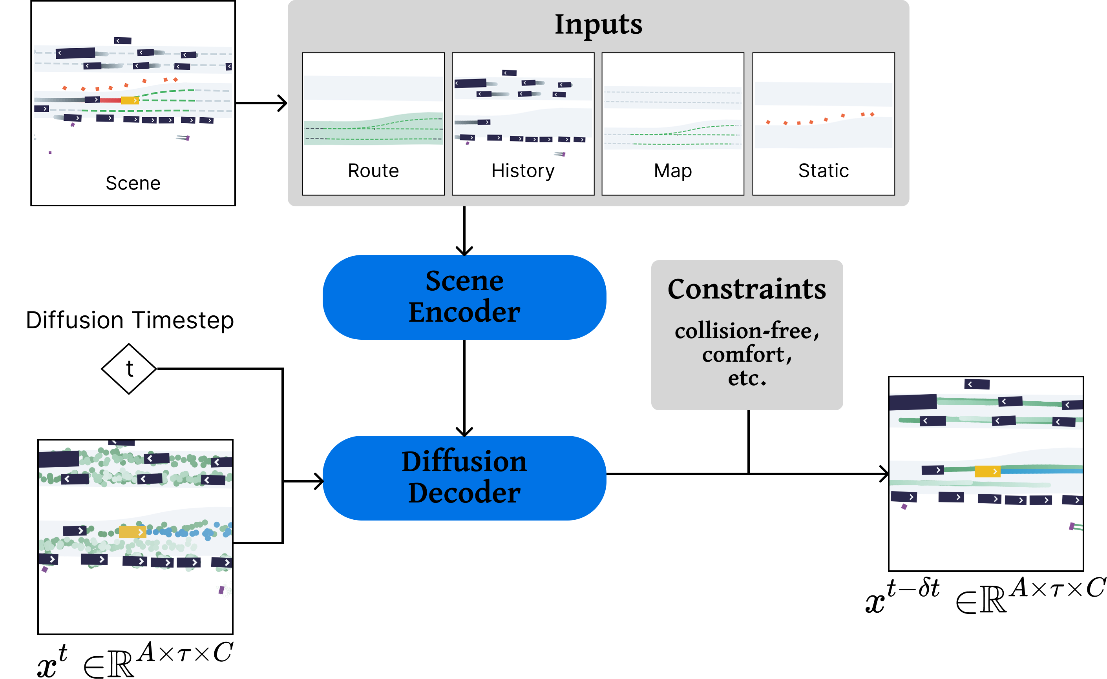
Diffusion Model as An Imitative Motion Planner
Our diffusion-based planner uses a scene encoder and a diffusion decoder to model joint futures of the ego vehicle and other agents. Constraints can be imposed to steer the ego trajectory towards safe and comfortable outcomes.
Scene Encoder
Encode scene inputs (map, history, etc.) into scene embedding
Diffusion Decoder
Predict other agents' behavior and generates optimal ego plan simultaneously.
Jointly models the multi-modal interactions between ego and the environment (agents, map, etc.).
Inference-Time Constraints
Differentiable constraints (e.g. collision-free reward) can be applied during inference without any additional training.

Slide 9
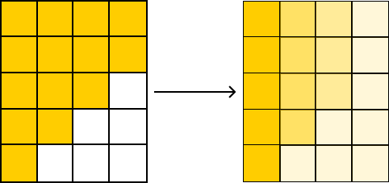
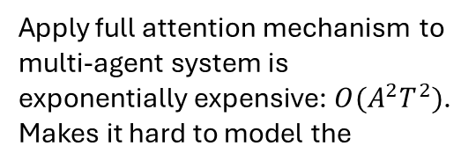
However, it does not perform well when …
1. Agent interactions grow exponentially complicated.
2. Dataset collected in real world is incomplete.
3. Planner executions under varying constraints during inference.
Apply full attention mechanism to multi-agent system is exponentially expensive: $O(A^{2}T^{2})$. Makes it hard to model the
During training, missing states will attend observed states when perform attention. This will bias the model learning process.
Guidance will drive states to out-of-distribution area which are not covered during training.
​ | Score​
w/o Constraint​ | 90.59​
w/ Constraint​ | 75.68​
Table 1: SOTA model performance before and
after applying collision-free guidance
Guidance gradient
Fig. 1: Planning Score of SOTA method w.r.t. Number of Agents
Fig. 2: Attention weights corrupted by missing states.
Fig. 3: Apply guidance gradient

Slide 10
We need a good model architecture first!
A good diffusion model architecture should be
Scalable – Efficient training when model weights get larger
Handle complex multi-agent interactions when number of agents increase
Preventing attention weights from missing states corruptions

Slide 11
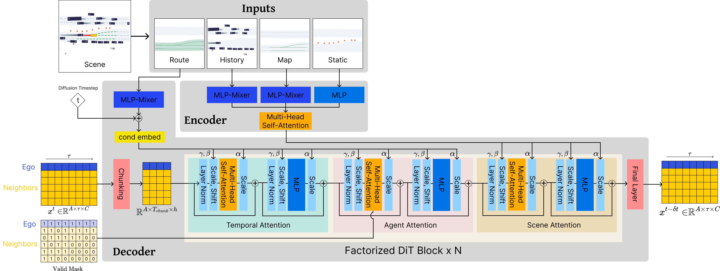
Model Architecture
We enhance the capabilities of state-of-the-art diffusion-based planners with our proposed improvements.
A chunking layer learns compact embeddings of trajectories.
N factorized DiT block composes of temporal attention, agent attention, and scene attention.
A final layer that broadcasts the embeddings to corresponding shape.

Slide 12
Quantitative Results
Num. of Samples | w/o Constraint | w/ Constraint | Difference
0.5 million | 88.41 | 70.27 | -18.14
1 million | 86.43 | 71.16 | -15.27
5 million | 89.2 | 74.66 | -14.54
10 million | 87.22 | 77.37 | -9.85
Result 1: Our architecture performance improves with the increasing number of predicted agents.
Result 2: Training with a broader dataset can alleviate the harm of inference-time constraints.
Parameter Size | Score
Small (8 M) | 84.38
Medium (10 M) | 87.51
Large (12 M) | 88.64
SOTA (6 M) | 77.95
Result 3: Scaling up the number of parameters can effectively improve the performance of our model.
Hyunki Seong et. al, Learning to drive at unsignalized intersections using attention-based deep reinforcement learning, ITSC 2021

Slide 13
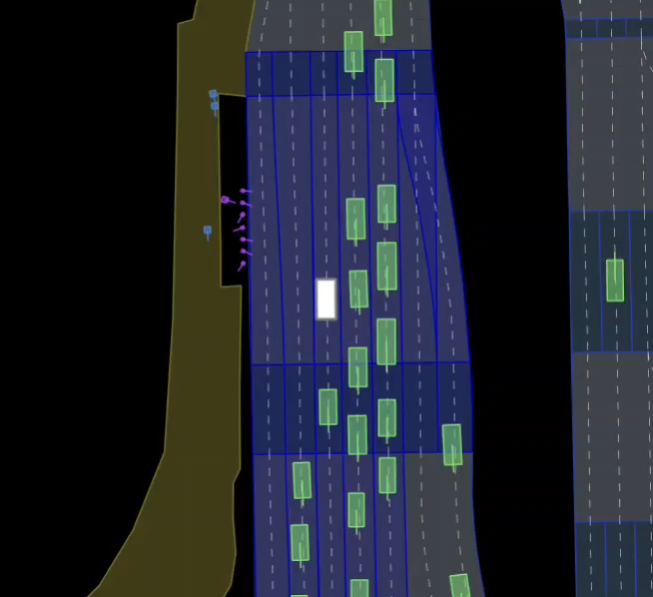
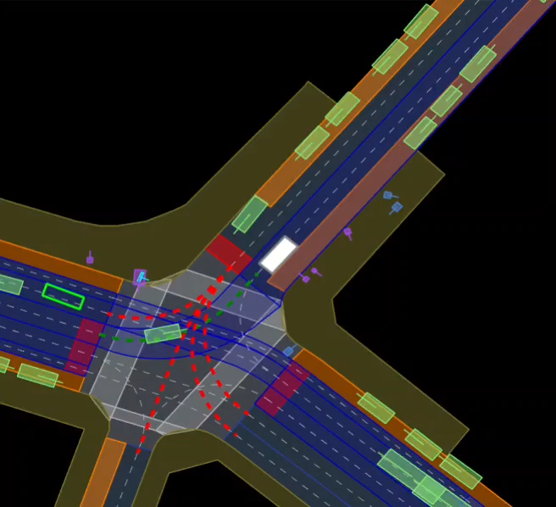
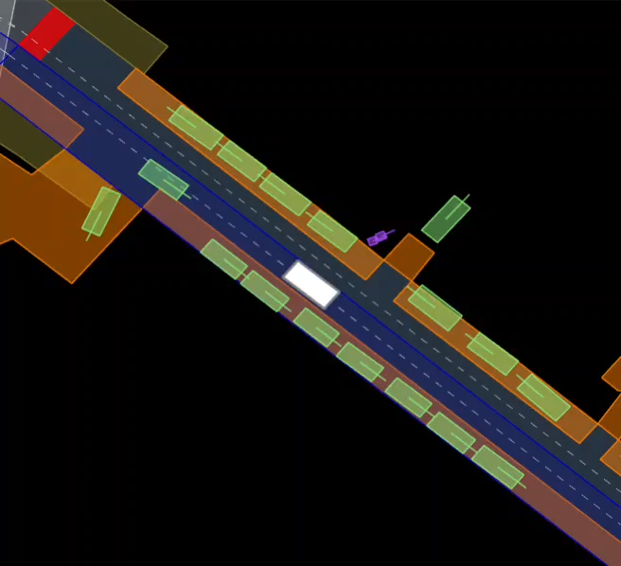
Qualitative Results
Slow down and wait for other vehicles to accelerate
Intersection with stop sign
Interaction at an intersection with stop sign

Slide 14
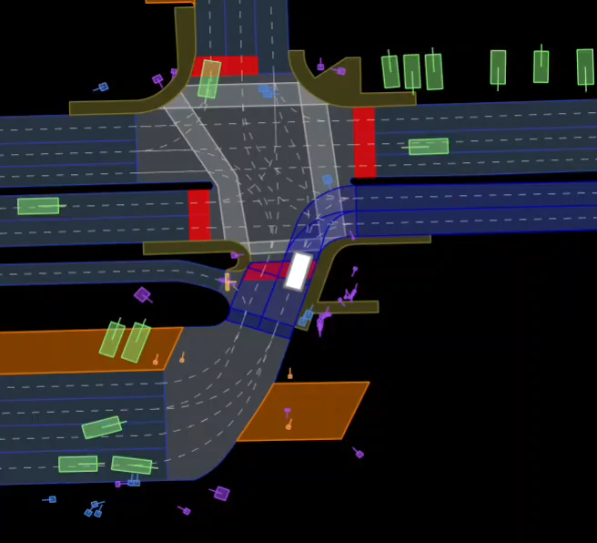
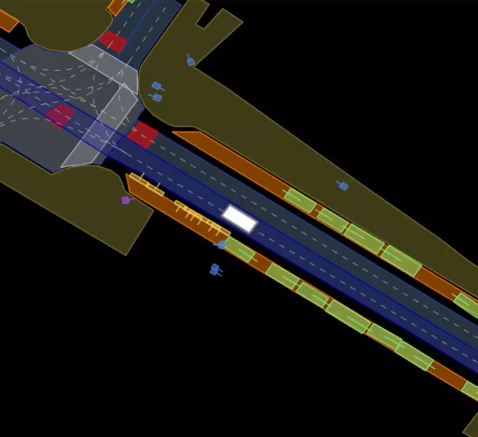
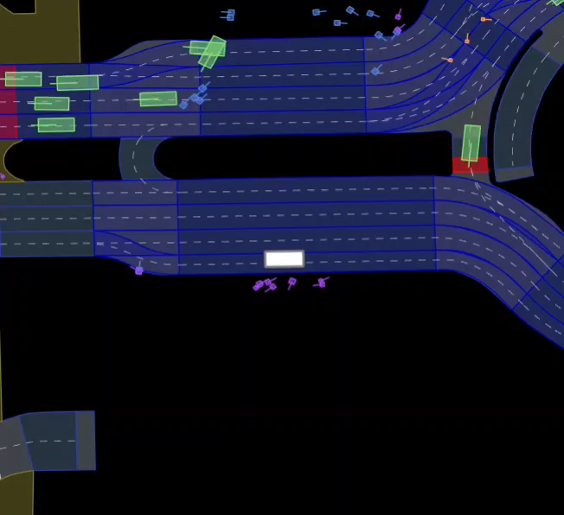
Qualitative Results
Wait for one pedestrian crossing and turn right before another pedestrian
Slow down for another vehicle pass first on a narrow road
Interaction at pickup area

Slide 15
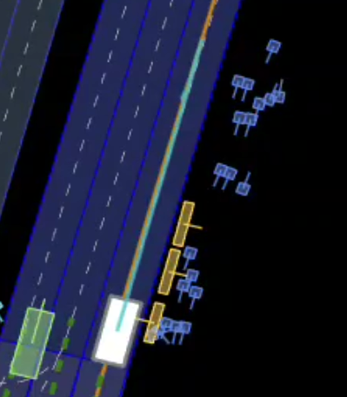
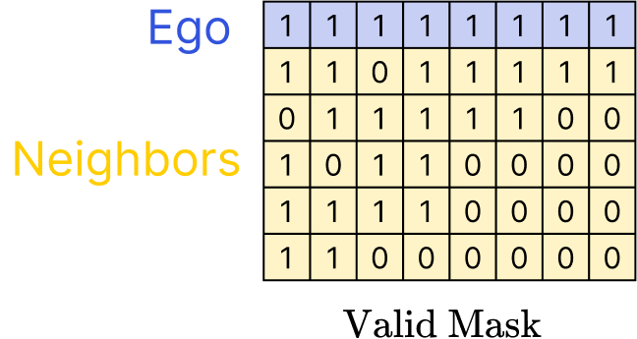
Problem is not fully solved yet …
We would like to avoid using valid mask at all.
Ego plan near the end is sometimes unrealistic
Valid mask we apply during training usually have ~40% missing states near the end. Meaning we are dropping 40% attention weights structurally.
During inference, such mask is not available because we would like to predict all agent behaviors.
Mask during training has a big gap from inference.

Slide 16
Problem is not fully solved yet …
Training on a very large dataset
Does not solve performance degradation fully caused by inference-time constraint.
Cause performance degradation of the base model because of the extrema imbalance in the large dataset.
Num. of Samples | w/o Constraint | w/ Constraint | Difference
0.5 million | 88.41 | 70.27 | -18.14
1 million | 86.43 | 71.16 | -15.27
5 million | 89.2 | 74.66 | -14.54
10 million | 87.22 | 77.37 | -9.85
Result 2: Training with a broader dataset can alleviate the harm of inference-time constraints.

Slide 17
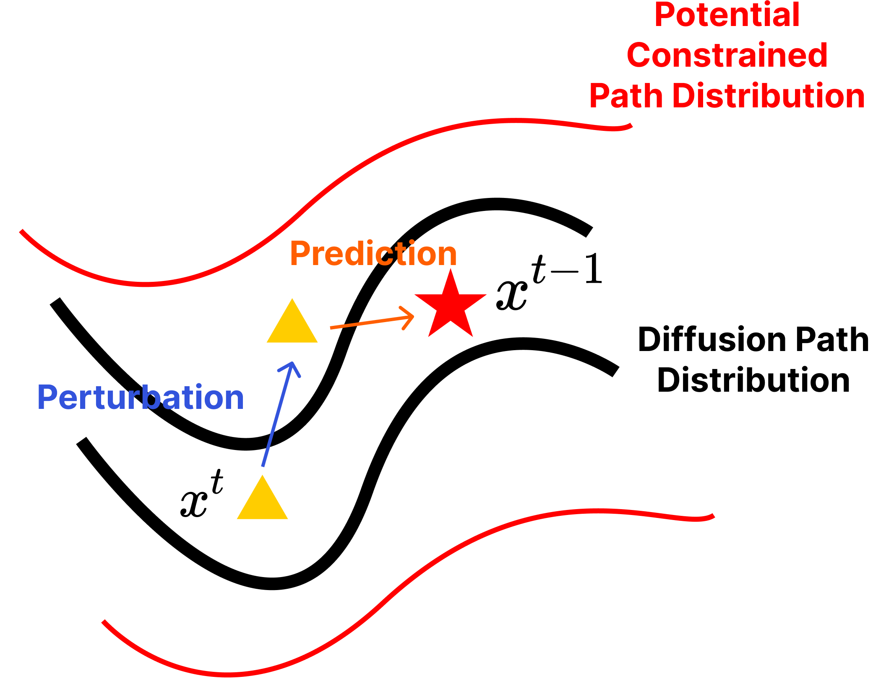
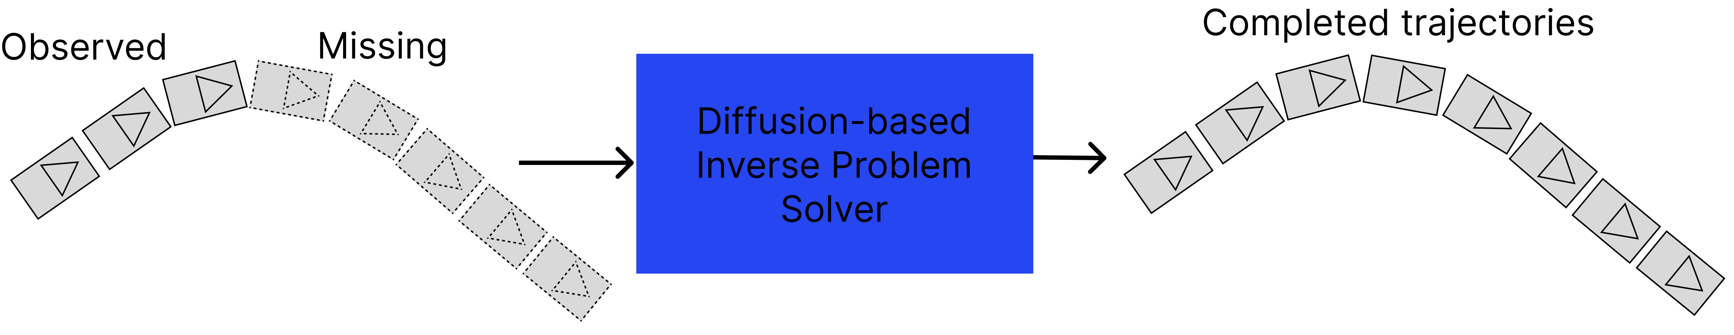
Future Work
Addressing incomplete trajectories by learning from corrupted data
Curing negative effect of inference-time constraints
Learn a diffusion-based restoration model that reconstructs missing agent behaviors from available observations using an inverse problem solver.
The completed dataset also enhances downstream tasks such as tracking and prediction.
Introduce training-time noise perturbation to improve model robustness and reduce the gap with the constrained distribution.
Expand the training dataset to better cover a broader range of scenarios.
Fig. 4: A restoration model takes an incomplete data sample and recover the missing states.
Fig. 5: Perturbing intermediate states. Prediction of next state should always stay in Diffusion Path distribution.

